Slide 1
Mediterranean Coast Guard Functions Forum
Naples, Italy
International Conventions for marine pollution
Antonio Bandini
Chairman, 1992 IOPC Fund Assembly
30 September 2022

Slide 2
Scope of this presentation
Liability and compensation issues arising from an incident
Who is liable to pay for the damage and the costs?
What kind of damage and costs are compensated?
Incident
Liability and Compensation for Marine Pollution from Oil
Prevention of Marine Pollution
Response to Marine Pollution

Slide 3
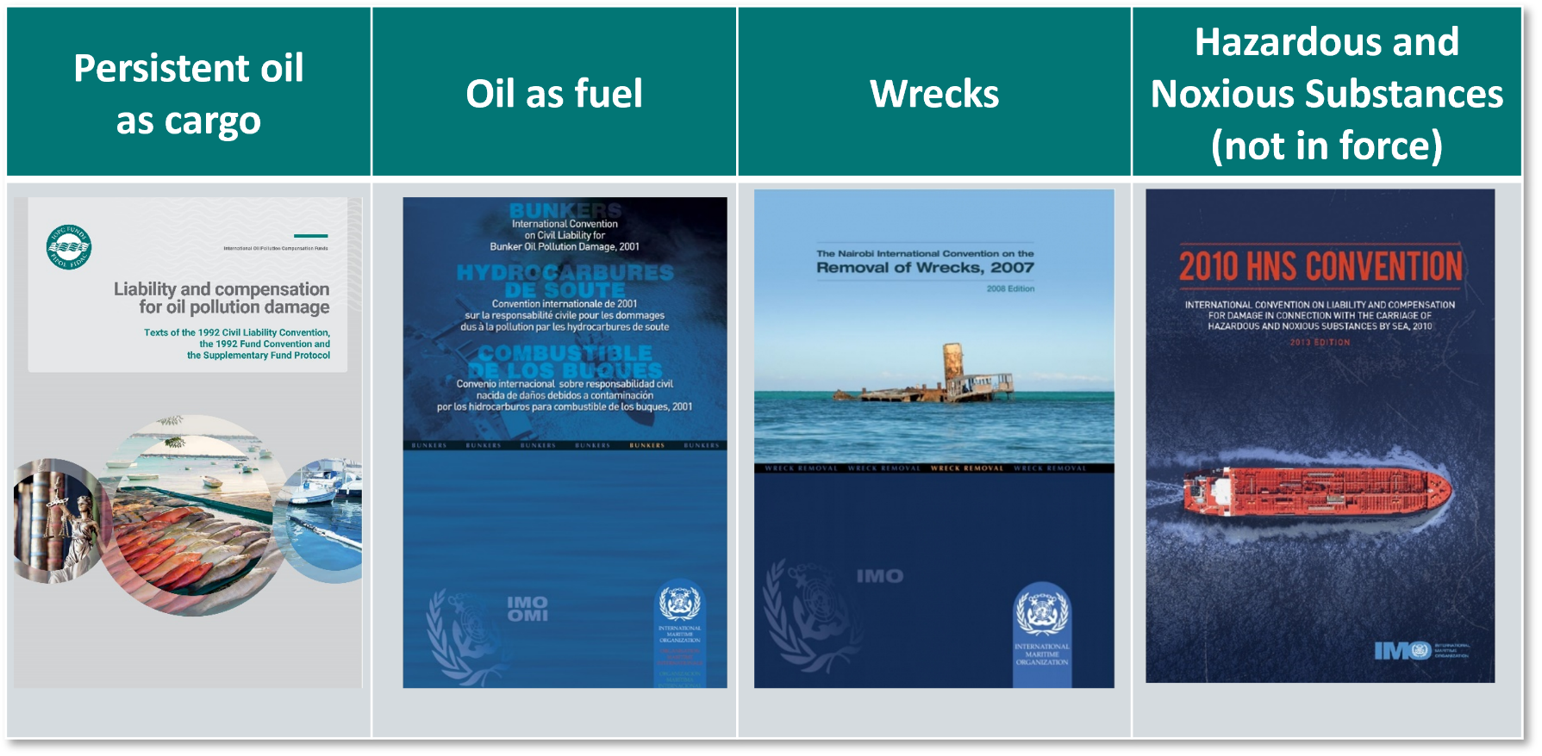
International Liability Conventions
An overview
IMO has developed several Conventions for dealing with liability and compensation arising from marine pollution
These Conventions create international uniformity in maritime law

Slide 4
Why do they exist?
Torrey Canyon incident
Date: 18 March 1967
Cause of spill: Grounding
Quantity transported: 120 000 tonnes of crude oil
Quantity spilled: whole cargo
Unprecedented scale of pollution damage, impacting coastlines, fishing waters and the livelihoods of many victims
Absence of international rules on liability and compensation in an oil spill
Led to the establishment of a regime for compensation for victims of oil pollution from tankers
Seven Stones Reef

Slide 5
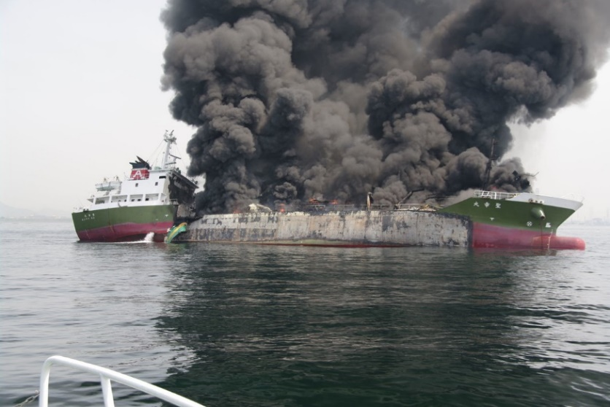
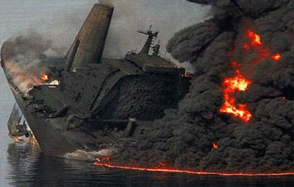
The international liability and compensation regime
Basic principles
Provide compensation to victims of pollution damage through amicable settlement
Share the cost of compensation between shipowner/insurer and oil receiver (through IOPC Funds)
Ensure uniform consistent application of compensation regime
Ensure equal treatment of all claimants

Slide 6
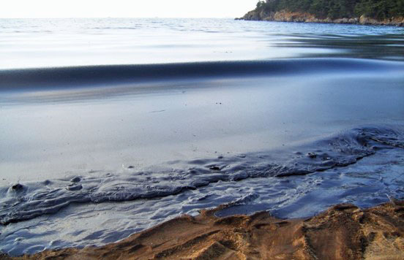
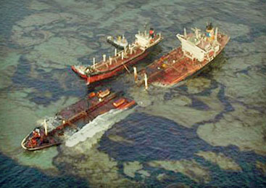
Scope of application
Overview
Provides compensation to:
victims of pollution damage caused by persistent oil from ships (tankers)
Applies to:
territory, territorial waters and exclusive economic zone (or equivalent) of Member States
Applies to “mystery” spills

Slide 7
How the regime works
Three Tier system
Source of money
Paying organisation/
Compensation regime
Oil receivers in Supplementary Fund States Parties
Supplementary Fund
Supplementary Fund Protocol
Third Tier
Claimants
Contribution
Oil receivers in 1992 Fund States Parties
1992 Fund
1992 Fund Convention
Second Tier
Contribution
Payment
Shipowner
Insurer (P&I Clubs)
1992 Civil Liability Convention First Tier
Insurance Premium

Slide 8
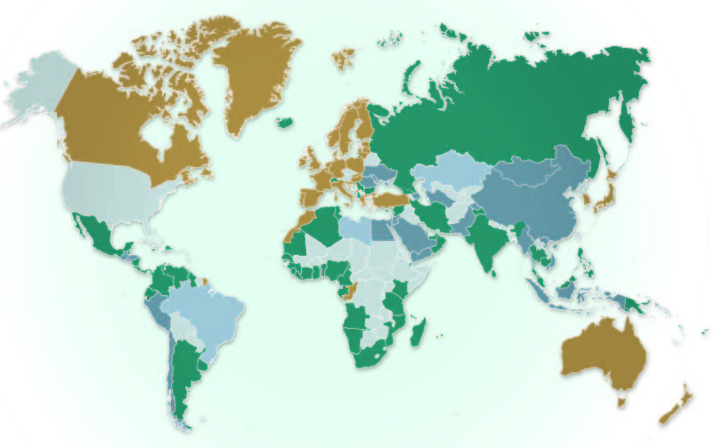
Member States
June 2022
SDR 750 million =
Eur 969 million
SDR 203 million = EUR 262 million
SDR 89 million = EUR 116 million
SDR 14 million = EUR 18 million
1992 Fund Convention (121 Member States)
1992 Civil Liability Convention (146)
Supplementary Fund (32)
1969 Civil Liability Convention (32)
States which have deposited an instrument of accession or denunciation, but for which the Convention has not yet entered into force or ceased to be in force, have also been reflected.

Slide 9
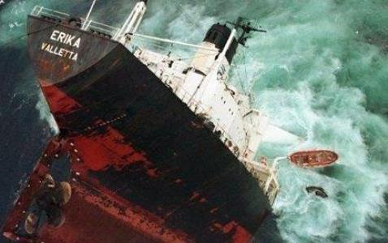
1992 Civil Liability Convention
First Tier
Strict liability of registered shipowner (channelling of liability to shipowner)
Limitation of liability based on the gross tonnage of the ship
Shipowners required to have compulsory third party insurance and certificate
Direct action against insurer
Exclusive jurisdiction where the damage occurred
Few exceptions to liability:
act of war. or natural phenomenon (force majeure)
wholly caused by an intentional act or omission by a third party
was wholly caused by negligence or wrongful act of public authorities
Shipowner cannot limit liability
if it is proved that the damage resulted from the owner’s personal act or omission, committed with the intent to cause such damage, or recklessly and with knowledge that such damage would probably result

Slide 10
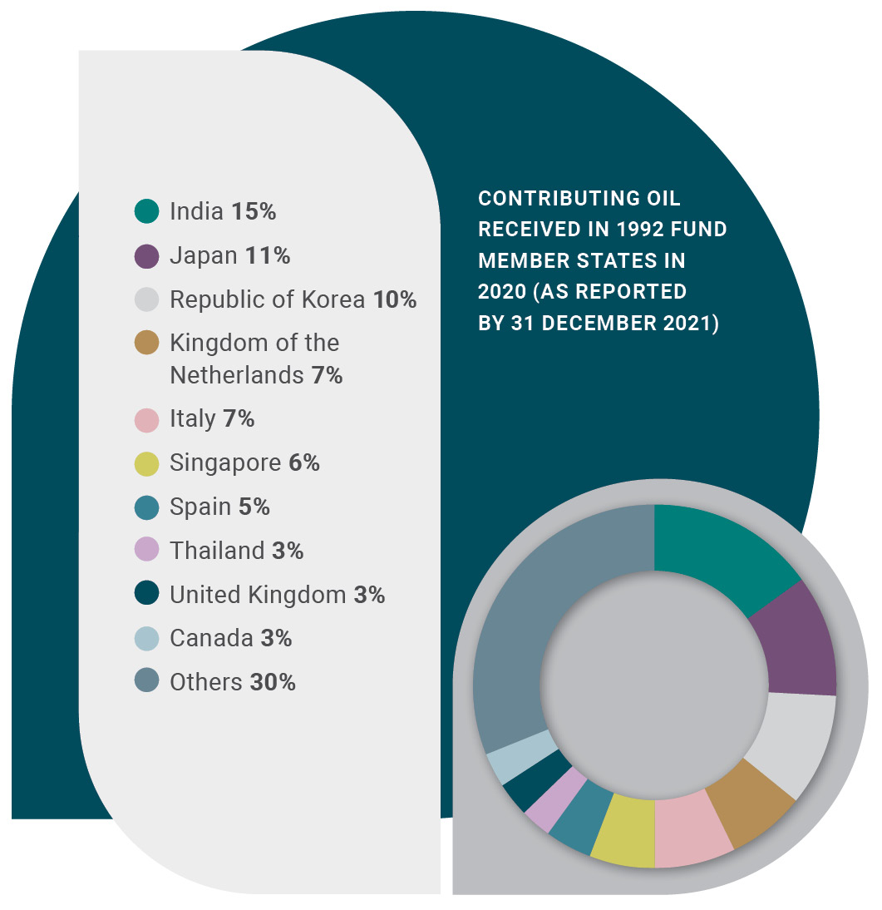
1992 Fund Convention
Second Tier
Pays compensation when:
damage exceeds shipowner’s liability
under the 1992 CLC
shipowner is financially incapable of
meeting their obligations
no liability under the 1992 CLC
Maximum compensation SDR 203 million, including CLC
Contributions from oil receivers in
States Parties to the 1992 Fund Convention
Very limited exceptions for compensation
damage resulted from an act of war, damage caused by a State ship
claimant cannot prove that damage resulted from incident involving ship(s)

Slide 11
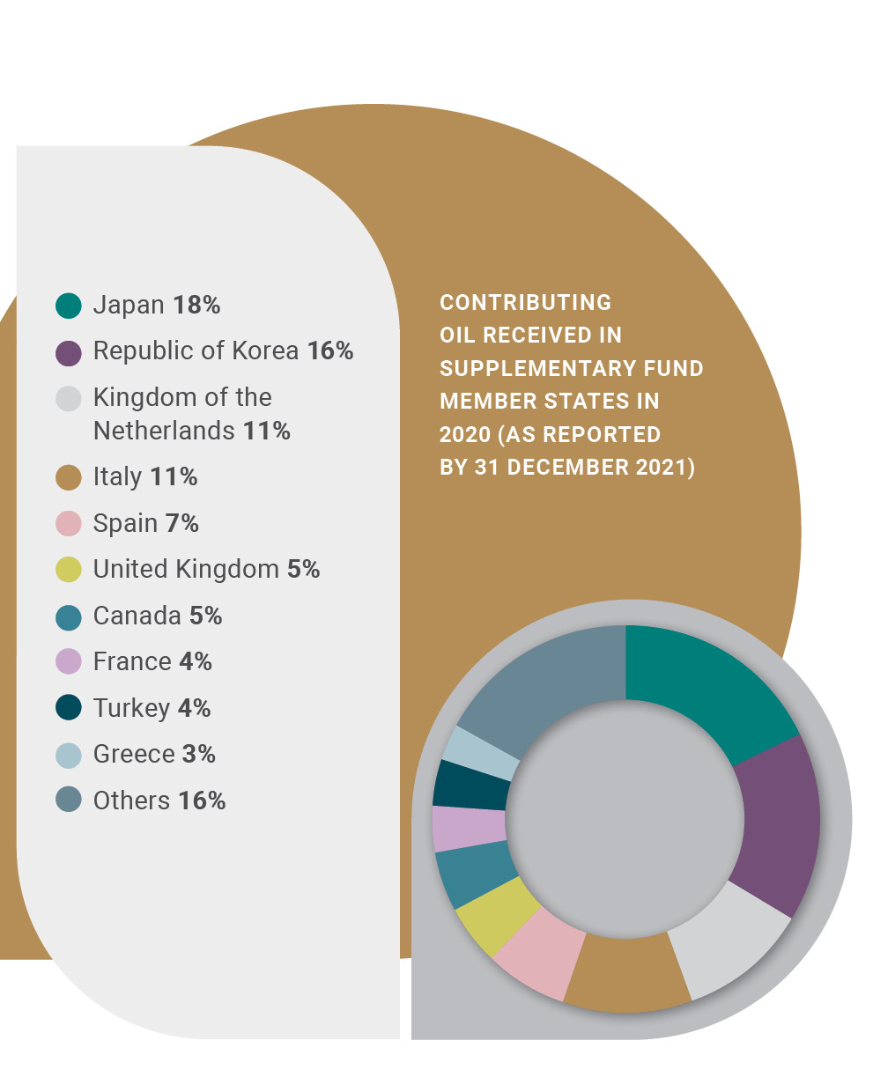
Supplementary Fund Protocol
Third tier
Pays compensation when damage exceeds, or there is a risk that it will exceed, the applicable limit under the 1992 Fund
Maximum compensation SDR 750 million, including amounts payable under 1992 Conventions
Contributions from oil receivers in States Parties to the Supplementary Fund Protocol
Minimum contribution: 1 million tonnes of contributing oil are deemed to be received in each State Party

Slide 12
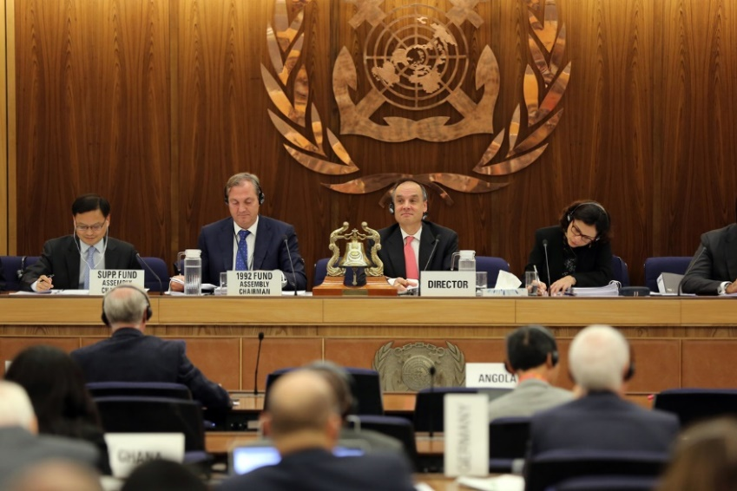
The role of the IOPC Funds
The basics
Administer the 1992 Fund Convention and the Supplementary Fund Protocol
Consists of Assemblies, Executive Committee and a joint Secretariat
Establish criteria for admissibility of claims
Assess claims and pay compensation to victims when applicable
Receive oil reports and contributions

Slide 13
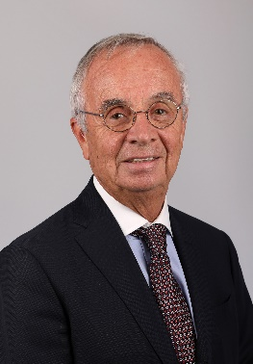
Governing bodies
Functions of the governing bodies
1992 Fund Assembly
Usually meets twice per year (regular and extraordinary sessions)
Variety of functions: appointment of Director, budget, accounts, policy issues, establishment of subsidiary bodies.
Chair
Ambassador Antonio Bandini
(Italy)
1992 Fund Executive Committee
Usually held twice a year
Functions to take decisions and instruct Director on matters relating to claims for compensation.
Chair
Samuel Soo
(Singapore)
Supplementary Fund Assembly
Has the same functions and sessions as 1992 Fund Assembly.
Secretariat of the 1992 Fund also administer the Supplementary Fund
Chair
Mr Sungbum Kim
(Republic of Korea)

Slide 14
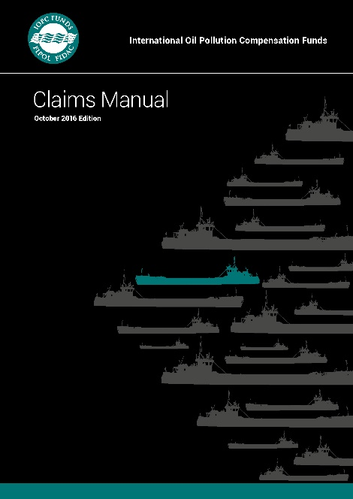
Functions of the Secretariat
Handling of claims
The Secretariat applies the assessment criteria adopted by the Assembly.
If a matter of principle arises, it is brought to the governing bodies for a decision.
Local Claims Handling Office
Advice/ report
Governing bodies
Decision making
Secretariat
Management of incident
Claimants
Claims
Matters of principle
Fund
lawyers
Technical
experts
Instruct supervise
Member State
IOPC Funds Headquarters

Slide 15
Types of claims
What is covered
Costs of clean-up and preventive measures
Economic losses by fisherfolk or those engaged in mariculture
Property damage
Economic losses in the tourism sector
Costs of reinstatement to the environment

Slide 16
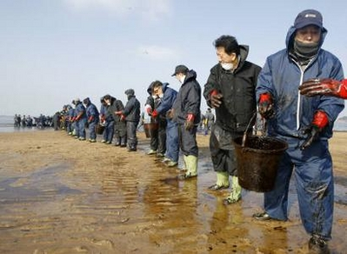
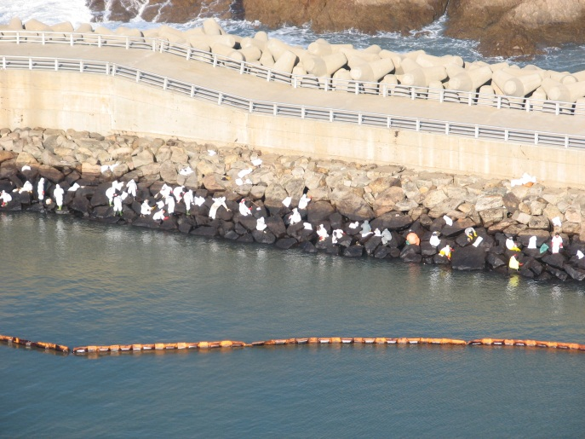
Admissibility criteria
General criteria
For a claim to be admissible for compensation:
link of causation
proven loss or damage
economically quantifiable
reasonable and justifiable measures
loss must have been incurred

Slide 17
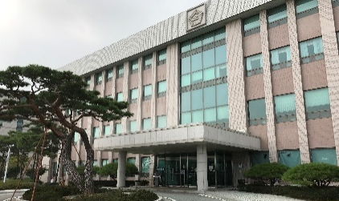
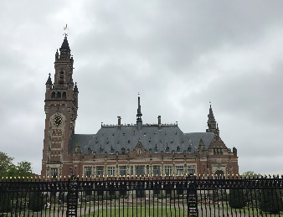
Claims procedure
National courts have final say
The IOPC Funds apply the criteria to pay claims adopted by Member States, however the final judgment of each Member State national court binds any claim dispute
No international court involved
Implementation of Conventions is crucial
Member State
International
National Court
International Court
judgment
judgment
Insurer
Insurer
dispute
dispute
apply criteria uniformly
Member State judgment
apply criteria uniformly

Slide 18
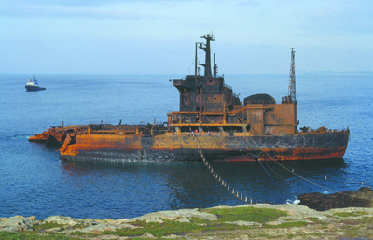
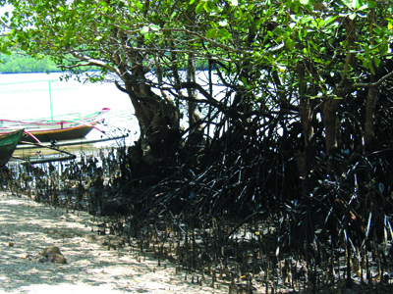
Time bar
Rights to compensation shall be extinguished unless action is brought
within 3 years from the date of damage
in any case, within 6 years from the date of the incident
Majority of claims are settled out of court within 3 years

Slide 19
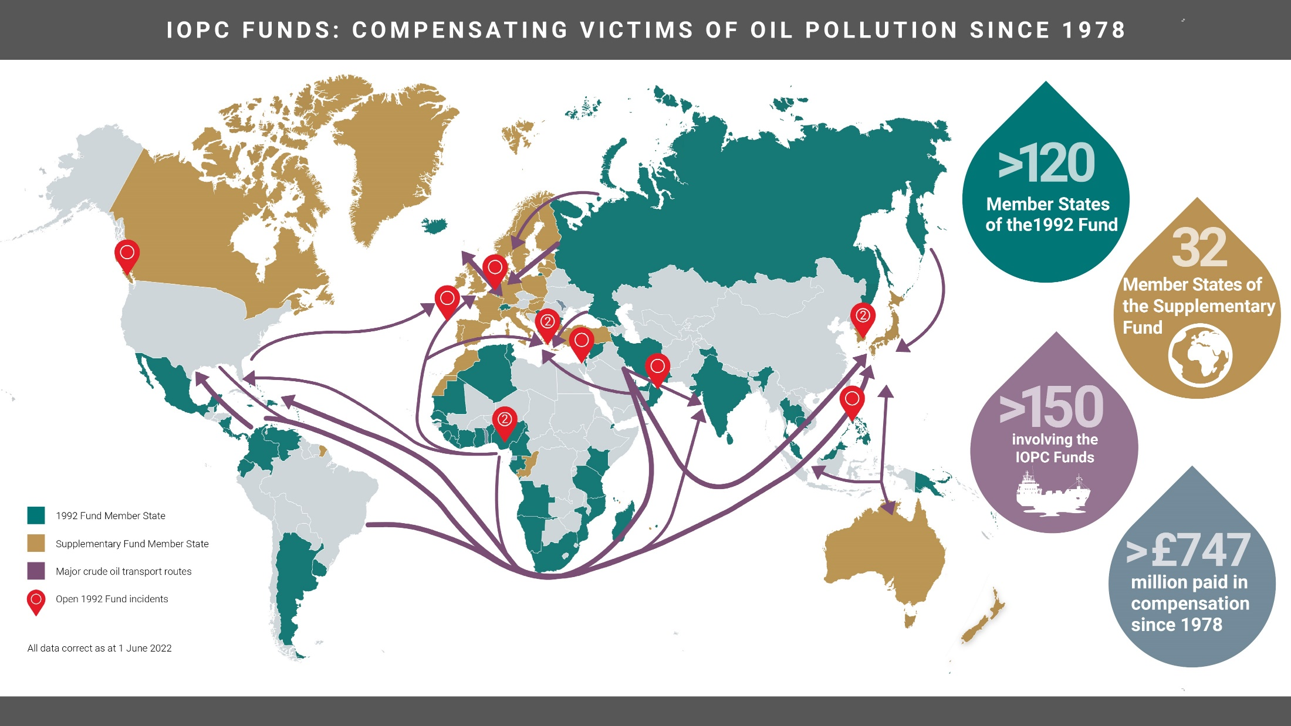
The international regime for compensation for oil pollution damage
@IOPCFunds
www.iopcfunds.org

Slide 20
Prestige
The largest and most controversial incident
On 19 November 2002, the Bahamas-registered tanker Prestige (42 820 GT), carrying 76 972 tonnes of heavy fuel oil, broke in two and sank some 260 kilometres west of Vigo, Spain. The bow section sank to a depth of 3 500 metres and the stern section to a depth of 3 830 metres. The break-up and sinking released an estimated 63 200 tonnes of cargo that was subsequently estimated that approximately 13 700 tonnes of cargo remained in the wreck.
Unlike the policy adopted by the insurers in previous IOPC Funds’ cases, the London P&I Club decided not to make individual compensation payments up to the shipowner’s limitation amount. This position was taken following legal advice that if the Club were to make payments to claimants in line with past practice, it was likely that these payments would not be taken into account by the Spanish courts when the shipowner set up the limitation fund, with the result that the Club could end up paying twice the limitation amount. The Fund therefore started paying from the beginning. Initially the level of payments was set at 15% of the established losses.

Slide 21
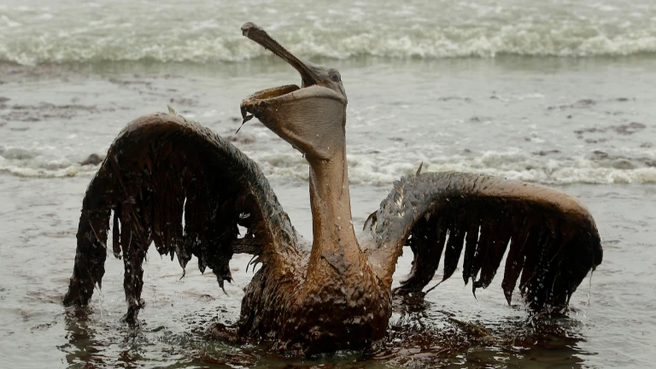
Prestige
Moral and Environmental damages
The Spanish Court of Appeal recognised the possibility of moral damages, which included not only the sense of fear, anger and frustration that may have affected many of the Spanish and French citizens, but also the mark that may have been left by the notion that catastrophes of the Prestige kind could affect these citizens at any time. The Court decided that in those cases where moral damage had been claimed, the amount awarded could not exceed 30% of the assessed material damages.
The 1992 Fund appealed, inter alia, on the basis of an infringement of the provisions in the Conventions, of arbitrary assessment of the evidence and for an internal contradiction between the reasonings and the findings as to the damages. In particular, in its pleadings the 1992 Fund requested the Court to declare that the 1992 Fund’s liability does not include pure environmental damage and moral damage, since these types of damages are outside the scope of the 1992 Fund Convention;
The Supreme Court’s judgment clarified that pure environmental and moral damages were not recoverable from the 1992 Fund. The Court however confirmed its previous decision that the London P&I Club was liable for all the damages caused by the incident, including moral and pure environmental damages, up to the limit of its policy of USD 1 000 million.

Slide 22
Hebei Spirit
Plenty of claimants
On 7 December 2007, the Hong Kong-registered tanker Hebei Spirit (146 848 GT) was struck by the crane barge Samsung Nº1 while at anchor about five nautical miles off Taean on the west coast of the Republic of Korea. The crane barge was being towed by two tugs when the tow line broke. Weather conditions were poor and it was reported that the crane barge had drifted into the tanker, puncturing three of its port cargo tanks.The Hebei Spirit was laden with about 209 000 tonnes of four different crude oils. Due to inclement weather conditions, repairs of the punctured tanks took four days to complete. However, as the tanker was almost fully laden, the possibilities for such actions were limited. As a result of the collision, a total of 10 900 tonnes of oil (a mix of three crude oils) escaped into the sea.A total of 127 483 claims were submitted to the Fund and Club and to the limitation proceedings. Very few claims were settled before the decision of the limitation court in 2013, and that decision on almost all the claims was appealed by the Parties. That significantly slowed the settling of the claims. The Korean government, but way of a Special Law, undertook to pay all claimants to the extent of their established claim and subrogated their claims to the Fund and Club. By 2018, all claims had been settled and paid.
On 7 December 2007, the Hong Kong-registered tanker Hebei Spirit (146 848 GT) was struck by the crane barge Samsung Nº1 while at anchor about five nautical miles off Taean on the west coast of the Republic of Korea. The crane barge was being towed by two tugs when the tow line broke. Weather conditions were poor and it was reported that the crane barge had drifted into the tanker, puncturing three of its port cargo tanks.
The Hebei Spirit was laden with about 209 000 tonnes of four different crude oils. Due to inclement weather conditions, repairs of the punctured tanks took four days to complete. However, as the tanker was almost fully laden, the possibilities for such actions were limited. As a result of the collision, a total of 10 900 tonnes of oil (a mix of three crude oils) escaped into the sea.
A total of 127 483 claims were submitted to the Fund and Club and to the limitation proceedings. Very few claims were settled before the decision of the limitation court in 2013, and that decision on almost all the claims was appealed by the Parties. That significantly slowed the settling of the claims. The Korean government, but way of a Special Law, undertook to pay all claimants to the extent of their established claim and subrogated their claims to the Fund and Club. By 2018, all claims had been settled and paid.

Slide 23
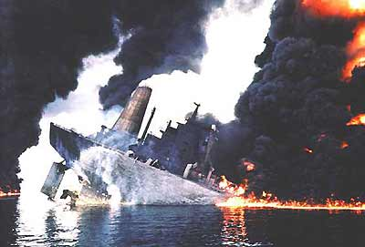
Haven
An accident in Italy
The MT Haven, a VLCC (very large crude carrier) loaded with 144,000 tonnes of crude oil, exploded in 1992, killing six Cypriot crew. It broke in two and sank after burning for three days.
The aggregate amount of the claims greatly exceeded the total amount of compensation available under the 1969 Civil Liability Convention and the 1971 Fund Convention. Eventually, the 1971 Fund entered into a global settlement with the Italian Government and the shipowner, by which the Fund paid a total amount of LIt 117.6 billion to the Italian government and claimants. The shipowner's insurer paid its limit under 69 CLC plus an ex gratia payment. The Fund also paid claimants in France (including the French Government) and the Principality of Monaco a total of 23 million Francs.

